Slide 1
Interpretation and Analysis of Metacells generated by the SEACells Algorithm
Harshit and Marek

Slide 2
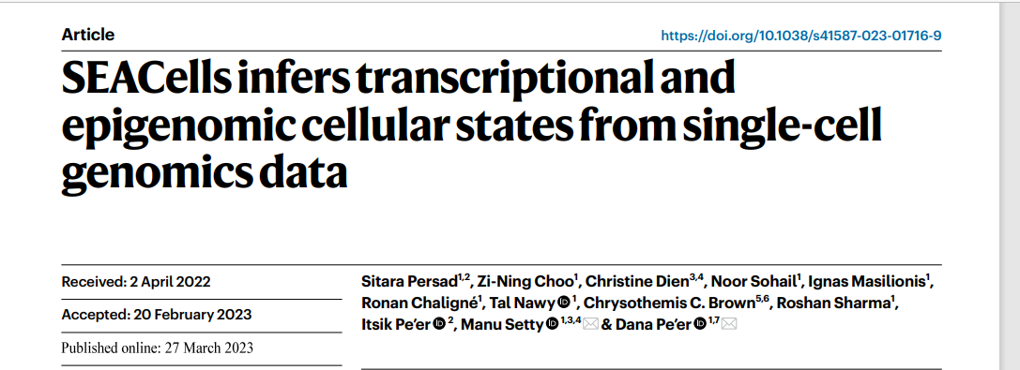
Reminder
Single cell data is noisy.
Traditional Clustering ends up aggregating heterogeneous cell types.
SEACells identifies metacells that can be seen as a collection of homogenous cells.

Slide 3
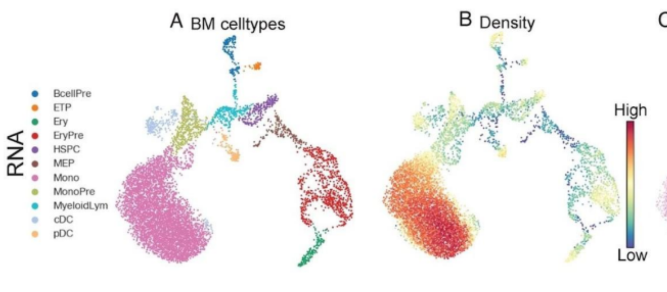
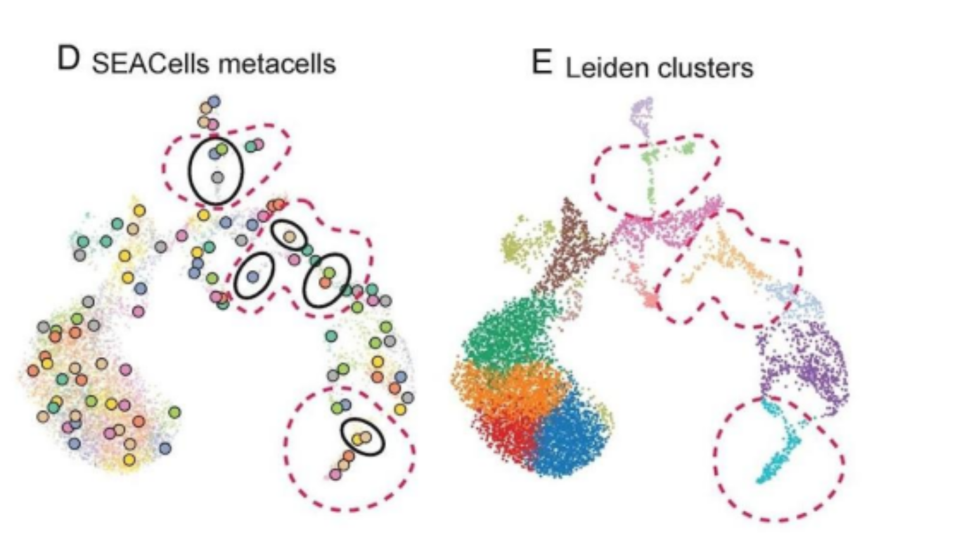

Slide 4
Algorithms Implemented
Convex Hull Construction:
Input: Similarity Matrix @ Archetype Matrix
Let G = NetworkX Graph.
for each SEACells Metacell do:
Add as a node to G: (SEACells assignment number, cell type, coordinates).
for each node i of G:
for each node j≠i of G:
Construct an edge between i and j.
return G
Project Cells to Edge:
Input: single row of cell similarity matrix, graph G
Let L be a list.
for each edge of G:
Let u, v = edge.
Let p, q = u,v coordinates.
v1, v2 = cell - p, q - p
t = dot product (v1, v2.T) / (v2, v2.T)
t = max(0, min(t, 1)).
Calculate projection.
Append to list L: distance = norm(cell - projection)
return argmin(L)
Project Cells:
Input: single row of cell similarity matrix, graph G
Let min_distance = ∞, closest_edge = None.
for each edge of G:
Let u, v = edge
Let p, q = u, v coordinates
v1, v2 = cell - p, q - p
t = dot product (v1, v2.T) / (v2, v2.T)
if t in [0,1]:
Calculate projection.
distance = norm(cell - projection)
if distance < min_distance:
min_distance = distance
closest_edge = edge
return closest_edge, min_distance

Slide 5
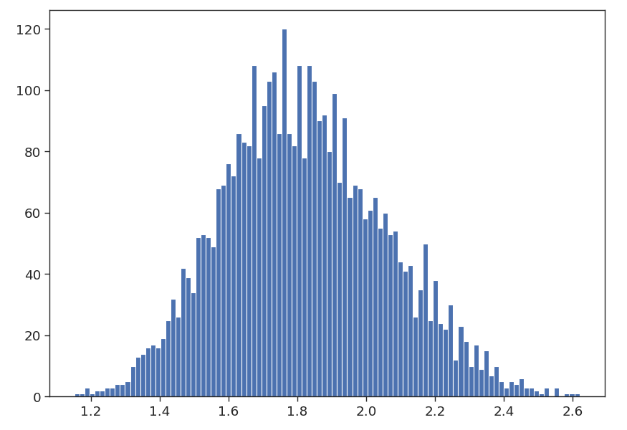

Progress Report
Distribution of the edge lengths of the convex hull

Slide 6
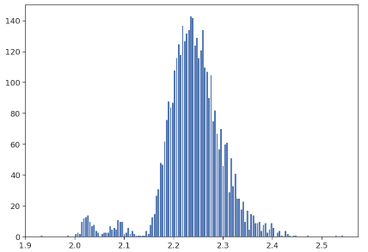
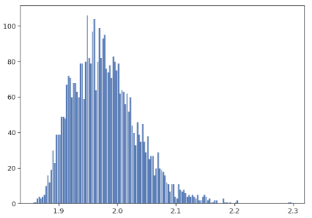
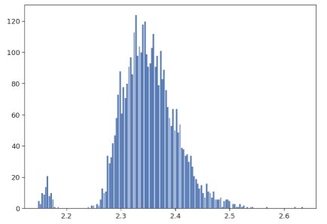
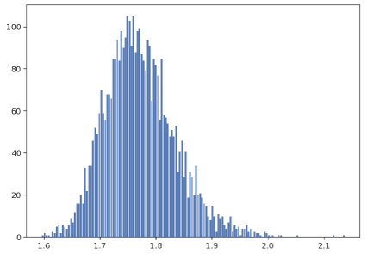
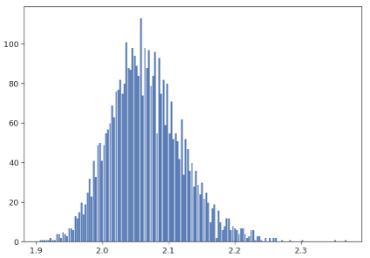
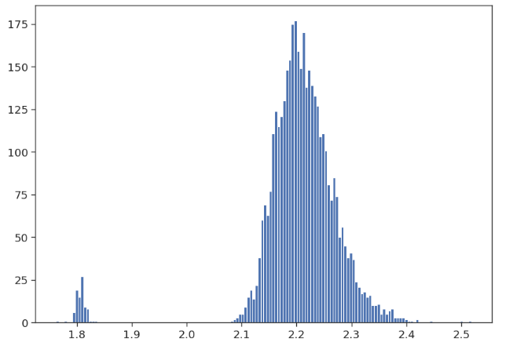
Distribution of Projection Distances of Cells to the edges of the Convex Hull
Cell 1
Cell 3
Cell 5
Cell 2
Cell 4
Cell 343

Slide 7
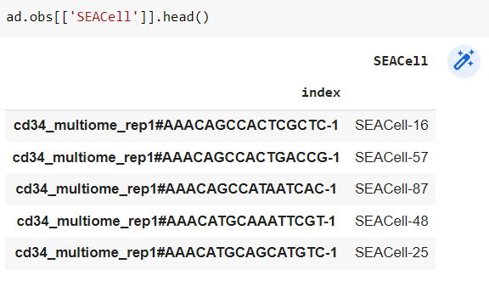
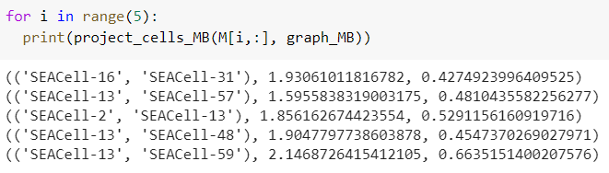
The edges don’t necessarily contain the cells assigned metacells

Slide 8
Plan Going Ahead
Chromatin Accessibility and Gene expression across Metacells (analysing the 1-d facets[edges] of the convex hull):
For each metacell pair identify statistical differences in open chromatin regions using sc-ATACseq data.
Are the differences more (quantify this) if the distance between metacells is longer?
Biological interpretation of this data for known references CD34+ and PBMC
Vary the number of metacells, see which chromatin states are disappearing or reappearing as we decrease and increase the number of metacells? Can this information help us find the optimal number of archetypes?
What is the expression status of Genes in this open chromatin region? Are they differentially expressed?
Do the above analysis for the sc-RNAseq data? Can Chromatin accessibility explain gene expression (multi-modal analysis)?
Running SEAcells and our analysis pipeline on new dataset and interpret the results.
END OF THIS WEEK

Slide 9
Going Forward
Come up with a strategy to interpret the 2-dimensional facets of the convex hull.
Isolate cells that occupy putative regions of interest on the convex hull and analyse them.
Employing Alternative Projection Methods?

